Slide 1
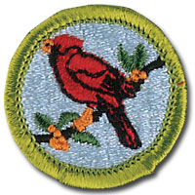
Bird Study Merit Badge
This basis for this Bird Study MB slide show was originally created by the Plainsboro Preserve of NJ Audubon.
Birds of Ohio
Part 1
Counselor: Mr. John F. Kennedy
Email: jfkennedy@fuse.net Phone: 513.631.5528

Slide 2
Merit Badge Requirements:
Explain the need for bird study and why birds are useful indicators of the quality of the environment.
Show you are familiar with the terms used to describe birds by sketching a perched bird and then labeling 15 different parts of the bird. Sketch an extended wing and label six types of feathers.
Demonstrate that you know how you properly use and care for binoculars.
Demonstrate that you know how to use a field guide including range maps.
Observe at least 20 kinds of birds and keep a field notebook as a record.
Be able to identify 5 of your 20 species by song or call alone. Enter a description in your records.
Go for a walk while recording the species you observe. Tell why some birds are common and some found only in small numbers. Tell why the area is good for finding birds.
Build a bird feeder.

Slide 3
Why Study BIRDS?!
a.) Because they’re pretty.
b.) Because they’re cool.
c.) Because all that walking around outside is good for you.
d.) Because birds are very useful indicator species.
e.) ALL OF THE ABOVE!

Slide 4
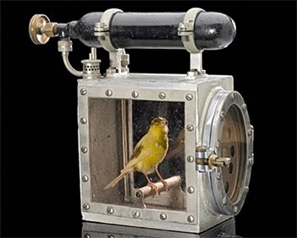
What’s an indicator species?
“Birds are indicators of the environment. If they are in trouble, we know we'll soon be in trouble.” - Roger Tory Peterson.
Several animals or species can act as indicators of environmental health. Birds are one such group that are often used for a number of reasons. Birds are everywhere and they are relatively easily seen and identified and we know a lot about them, their biology and their life-histories. Most people enjoy them for their beauty, their liveliness or their song. Ecosystems are usually so complex that no single component can speak for all the others. Nevertheless, birds can give an indication whether the system is healthy or otherwise, and their study can be a useful way to gain an understanding of ecosystems and their needs. Since a fully diverse ecology is needed to support a healthy number and range of species, a lower than expected number or range of species in an environment clearly indicates a lower ecological diversity.
Birds are particularly good as environmental indicators because they:
• live in almost every type of environment and in almost every niche (place or role) within those environments.
• are at the top of the food-chain and are therefore vulnerable to accumulating chemicals
• have representatives that depend on the full range of animal diets
• are easy to see and observe
• are already relatively well-known, providing a good baseline against which change can easily be monitored.
Birds have also been used as indicators of grassland, wetland, meadow, rainforest and desert health, of environmental hazards, and of changes in other types of biodiversity. Changes in living birds, both individuals and populations, are evidence of climate change and fossil birds have been used to indicate what past climates were like. Bird skins and eggs in museums have shown the history and damage caused by some pollutants, and changes in the timing of events in birds lives or in the places birds occur point to environmental change.
Northern Parula

Slide 5
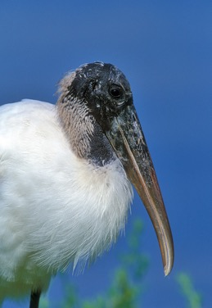
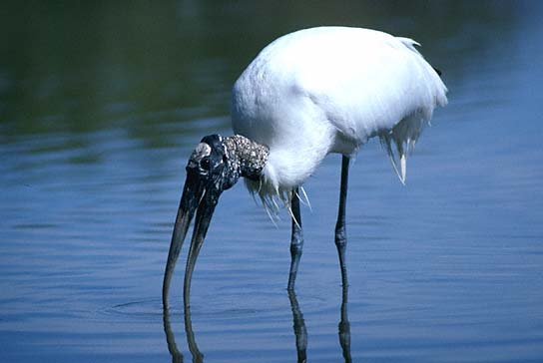
Indicator Species:
Wood Stork (Mycteria americana)
The Wood Stork is a bird that has adapted perfectly for life in semi-tropical climates. During their breeding season (the dry-season) they take advantage of the shrinking ponds where they feed. The concentrations of fish provide the 440 or so pounds of food that a pair of Wood Storks will need while they raise their young.

Slide 6
The Story:
In the 1930’s there were about 4,000 pairs of Wood Storks in the Everglades. By the 1980’s there were fewer than 300 pairs in the Everglades. Why?
Since people in south Florida began to control water levels in the marshes the flooding and drying patterns have changed a lot! The pools full of fish that the storks relied on don’t form if water levels are maintained artificially! There’s not enough accessible food for all of those birds, so we see fewer and fewer of them. Wood Storks are now an endangered species, and a similar decline was shown in all populations of Florida’s wading birds.

Slide 7
Bird Topography
When describing a bird to someone, it’s important that we’re all using the same words for the same parts. There are names for the parts of a birds body and also for the different kinds on feathers birds use in flight.

Slide 8
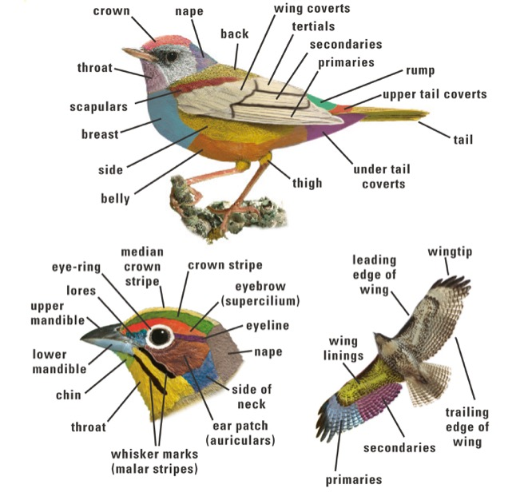

Slide 9
Mallard (Anas platyrynchos)
Female
Mostly brown
Mottled orange bill.
Male
Glossy green head.
White neck-ring.
Chestnut breast.
Female
Male
Habitat: Found on many bodies of water, including lakes, marshes, swamps and parks.

Slide 10
Canada Goose (Branta canadensis)
Head and neck black, with broad white cheek patch.
Body gray-brown; feathers under tail white.
Both sexes similar.
Habitat: Ponds, rivers, fresh- and salt-water marshes, and grain fields.

Slide 11
Mute Swan (Cygnus olor)
Huge.
Neck held in graceful curve.
White.
Orange bill with black knob.
Evil…?
Habitat: Ponds and lakes, usually close to where humans live.

Slide 12
Indigo Bunting (Passerina Cyanea)
The indigo bunting is a small bird. The male is a vibrant blue in the summer and a brown color during the winter months, while the female is brown year-round.
The diet of the indigo bunting consists primarily of insects during the summer months and seeds during the winter months.
Male
Habitat: Brushy pastures, bushy wood edges. For nesting favors roadsides, old fields growing up to bushes, edges of woodlands, and other edge habitats such as along rights-of-way for powerlines or railroads.
Female

Slide 13
Great Blue Heron (Ardea herodias)
Very large.
Long neck with an S-shaped curve.
Adults mostly gray; white head with two black crown stripes.
Bill yellow.
Habitat: Marshes, lakes, rivers, and shores.

Slide 14
Pileated Woodpecker (Dryocopus pileatus)
The Pileated Woodpecker is one of the biggest, most striking forest birds of North America. Adults are 16 to 19” long, wing spans of 26 to 30”, black with bold white stripes down the neck and a flaming-red crest.
Look (and listen) for Pileated Woodpeckers whacking at dead trees and fallen logs in search of their main prey, carpenter ants, leaving unique rectangular holes in the wood. The nest holes these birds make offer crucial shelter to many species including swifts, owls, ducks, bats, and pine martens.
Habitat: Conifer, mixed, and hardwood forests; woodlots. Favors mature deciduous or mixed deciduous-coniferous forest, also coniferous forest.

Slide 15
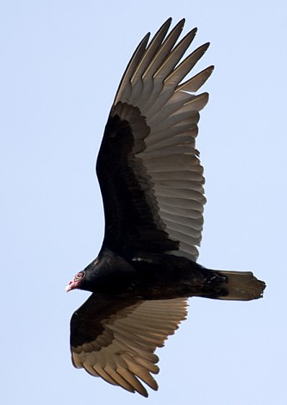
Turkey Vulture (Cathartes aura)
Dark with long, narrow wings.
Underside of flight feathers silvery.
Small head is red, with small white beak.
Dihedral
Turkey Vultures hold their wings above their bodies when they soar. This creates a shallow V shape. You can see this ‘dihedral’ from very long distances.
Habitat: Open country, farmland, and forests.

Slide 16
Review

Slide 17
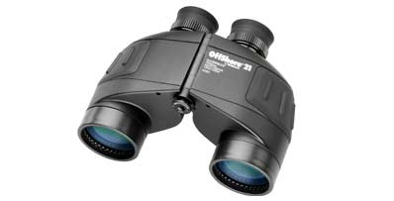
Please take out your
Binoculars
Binoculars are the most important and most commonly used tool for observing birds.
Most birders use 7X35, 8X40, or 10X50 binoculars.
What do these numbers mean?
Name the different parts of the binoculars.

Slide 18
The Parts of Your Binoculars
There are four parts on the outside of your bins that you should know the names of. These are:
1. The central focus ring changes the focus of your bins as you turn it back and forth.
2. The ocular lenses are the smaller ones that you look into.
3. The diopter ring (usually found on the right ocular lens) allows you to compensate for the difference between your right and left eyes.
4. The objective lenses are the larger lenses at the front of the bins. They allow light into the binoculars.

Slide 19
About the numbers…
The first number (usually an 8 or 10) refers to the magnification. 10 power binoculars make an image appear 10 times larger than it would if you looked at it without bins.
The second number (a double-digit number between 20 and 80) refers to the diameter of the objective lens (the larger front lens) in millimeters.

Slide 20
Osprey (Pandion aliaetus)
Large and long-winged.
White head with dark line through eye and across the cheek.
Back and wings brown.
Osprey fly with their wings above their body like Turkey Vultures do, but Osprey bend their wings back down at the wrists, making a distinctive shallow M.

Slide 21
Bald Eagle (Haliaeetus leucocephalus)
Adult is dark brown with white head and tail.
Large bill yellow.

Slide 22
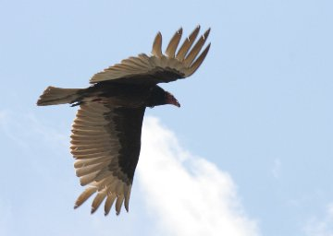
Bald Eagles vs. bald Vultures
Bald Eagle: ‘Bald’ because of its white head feathers.
Vulture: Actually bald.

Slide 23
POP QUIZ!
Can you name all the tracts of flight feathers in the eagles wing?

Slide 24
Ring-necked Pheasant (Phasianus colchicus)
Introduced Species
A large, chicken-like bird with a long, pointed tail. It has fairly long legs, a small head, long neck, and plump body.
Males sport iridescent copper-and-gold plumage, a red face, and a crisp white collar; their rooster-like crowing can be heard from up to a mile away. The brown females blend in with their field habitat.
Male
Female
Behavior: They forage on the ground in fields, where they eat waste grain, other seeds, and insects when available. They usually walk or run and only occasionally resort to flying, usually when disturbed at close range by humans or other predators. Males give a loud, cackling display that can be heard over long distances.
Habitat: agricultural areas intermixed with areas of taller vegetation, which they use for cover. Look for them along rural roadsides, in overgrown or recently harvested fields, and in brushy areas and hedgerows.

Slide 25
Red-tailed Hawk (Buteo jamaicensis)
Dark brown above, light below with dark ‘belly band.’
Adults have a brick-red tail.
Imm.
Habitat: Plains farms, deserts, and open woodlands.

Slide 26
American Kestrel (Falco sparverius)
Male
Rusty with blue gray wings.
Black spots on black and sides.
Female
Rusty with black bars on back and tail.
Female
Male
Both sexes have pointed wings and two stripes on their faces, sort of like a moustache and a sideburn.
Habitat: Open country, farmland, deserts and towns.

Slide 27
Peregrine Falcon (Falco peregrinus)
Broad black moustache below eye.
Adults are slate gray above, light below.
Immatures are blue-gray, streaked with brown below.
Adult
Habitat: Cliffs in open country or near water. Also near cities.
Immature

Slide 28
Wild Turkey (Meleagris gallopavo)
Chicken-like.
Metallic bronze with black barring.
No feathers on the head and neck.
Tail broad and fan-shaped, opened when male displays.
Females are slightly smaller and paler.
Habitat: Open woodlands, brushy forest edges and wooded swamps.

Slide 29
Review

Slide 30
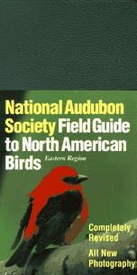
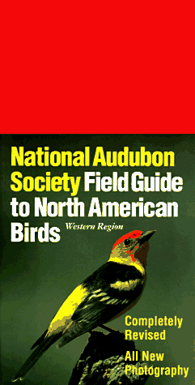
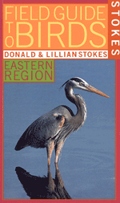
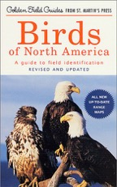
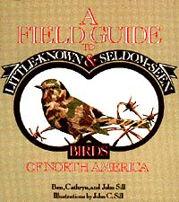
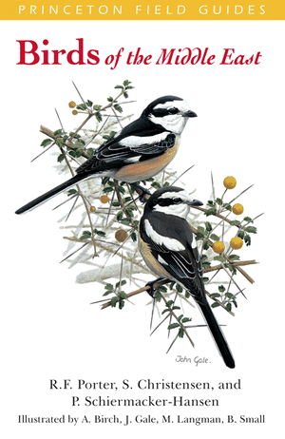
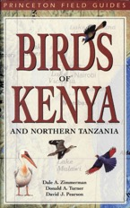
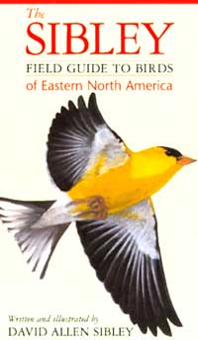
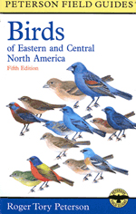
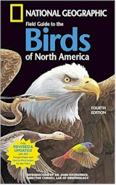
Field Guides

Slide 31
American Kestrel
Our smallest and most colorful falcon.
Often feeds on dragonflies and other flying insects.
Flight is flappy and bouyant.

Slide 32
Great Blue Heron

Slide 33
Mute Swan
Mate for life about 95% of the time.

Slide 34
Killdeer (Charadrius vociferus)
Upperparts brown, underparts white.
Two black breast bands.
Rump and base of tail rusty.
White wing stripe.
Habitat: Pastures, plowed fields, riverbanks, mud flats, and airports.

Slide 35
Barred Owl (Strix varia)
The Barred Owl’s hooting call, “Who cooks for you? Who cooks for you-all?” is a classic sound of old forests and treed swamps.
• An attractive owl, with soulful brown eyes
• brown-and-white-striped plumage
• members of a pair often will call back and forth to each other.
Although the bird is mostly active at night, it will also call and even hunt in the daytime.
Diet - Mostly small mammals. Eats many mice and other small rodents, also squirrels (including flying squirrels), rabbits, opossums, shrews, other small mammals. Also eats various birds, frogs, salamanders, snakes, lizards, some insects.
Habitat: Woodlands, wooded river bottoms, wooded swamps. Favors mostly dense and thick woods with only scattered clearings, especially in low-lying and swampy areas.

Slide 36
Bird Feeder Construction
Your Starting point….

