Slide 1
American Housing Styles
• American Colonial Styles 1600s - 1800 • Neoclassical House Styles 1780 - 1860 • Victorian House Styles 1840 - 1900 • Frank Lloyd Wright Styles 1901-1955 • Early 20th Century Styles 1905-1945 • Post-War Houses 1945-1980 • Contemporary Houses 1970-present

Slide 2
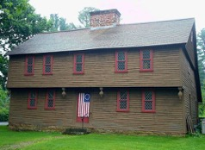
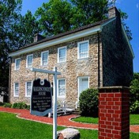
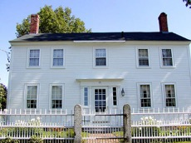
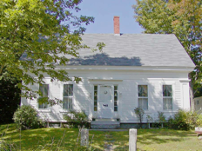
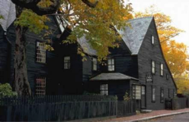
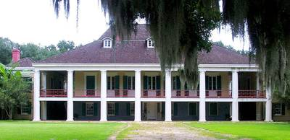
American Housing Styles - Colonial Styles
New England Colonial
Dutch Colonial
German Colonial
Georgian Colonial
New England Colonial House of the Seven Gables
Cape Cod
Spanish Colonial
French Colonial

Slide 3
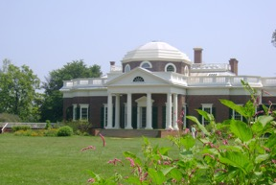
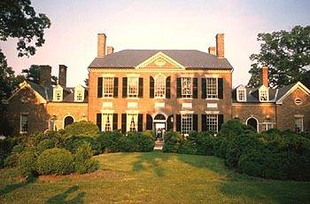
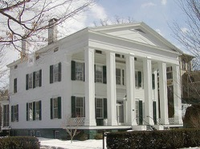
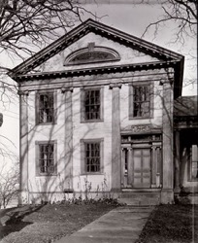
American Housing Styles - Neoclassical Styles
During the founding of the United States, many people felt that ancient Greece expressed the ideals of democracy. Architecture reflected classical ideals of order and symmetry.
Thomas Jefferson’s Monticello
Federal / Adams
Greek Revival
White House
Tidewater House Style George Washington’s Mt. Vernon
Greek Revival

Slide 4
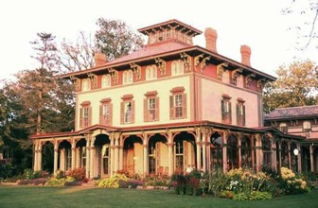
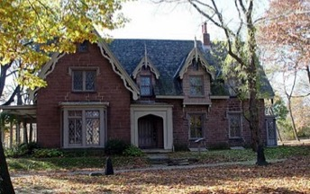
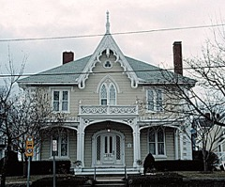
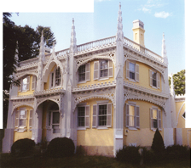
American Housing Styles - Victorian Styles
Mass-production and factory-made building parts made large, elaborate houses more affordable. A variety of Victorian styles emerged: Italianate, Second Empire, Gothic, Queen Anne, Romanesque, and many others. Each style had its own distinctive features.
Italianate
Richardsonian Romanesque
Gothic Revival - Masonry
Gothic Revival - Carpenter Gothic
Gothic Revival - Carpenter Gothic Wedding Cake House

Slide 5
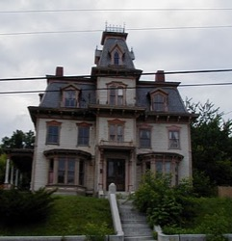
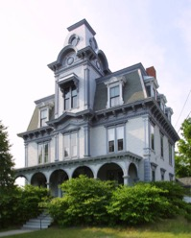
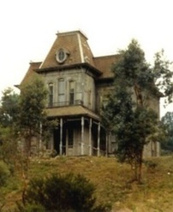
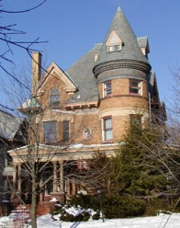
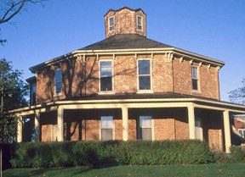
American Housing Styles - Victorian Styles
Second Empire
Second Empire
Second Empire
Queen Anne
Octogon
Queen Anne
Eastlake

Slide 6
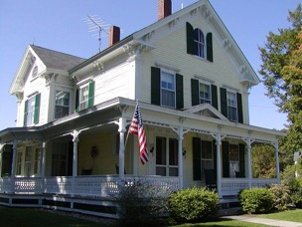
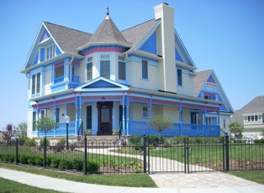
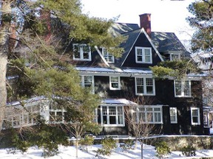
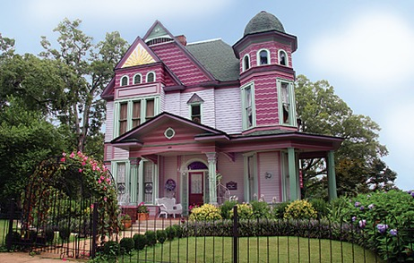
American Housing Styles - Victorian Styles
Folk Victorian
Folk Victorian / Queen Anne Painted Lady
Shingle Style

Slide 7
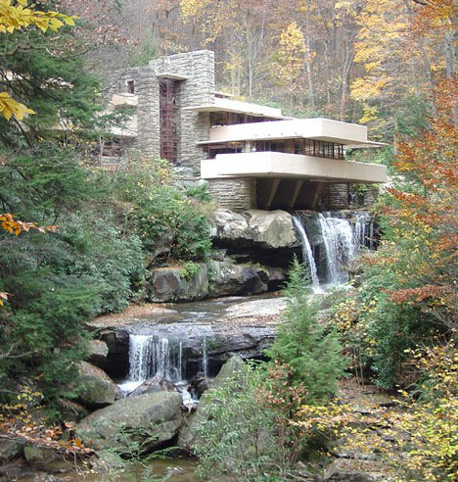
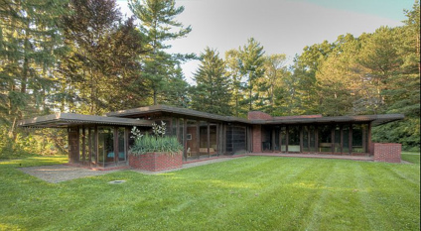
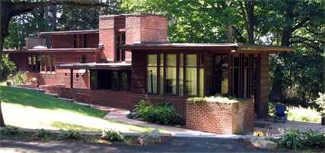
American Housing Styles - Frank Lloyd Wright / Prairie

Slide 8
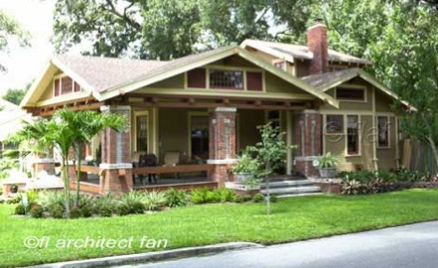
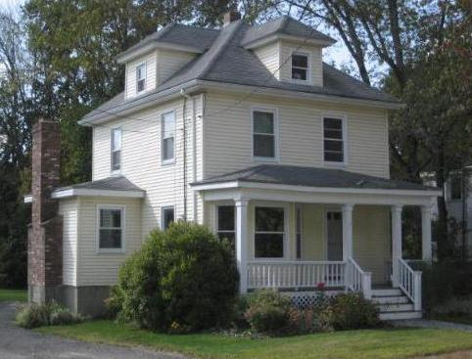
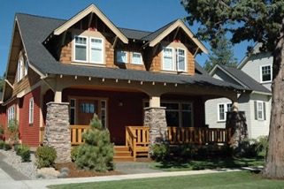
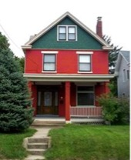
American Housing Styles - Early 20th Century
Arts & Craft / Bungalow
American FourSquare

Slide 9
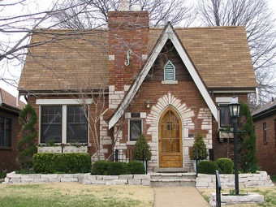
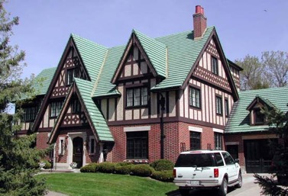
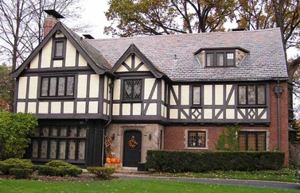
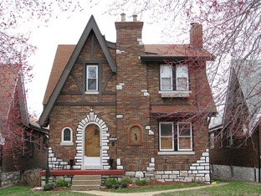
American Housing Styles - Early 20th Century
Tudor / English Revival

Slide 10
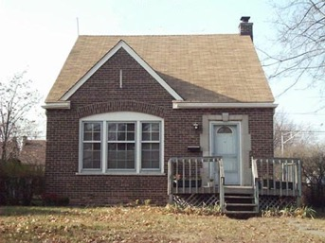
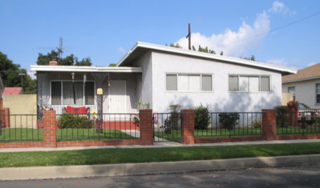
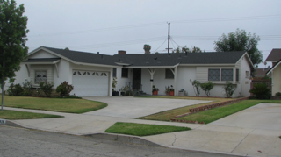
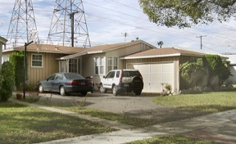
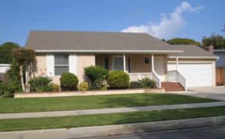
American Housing Styles - Post War Houses
John Connor’s House
Marty McFly’s House

Slide 11
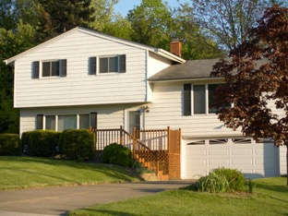
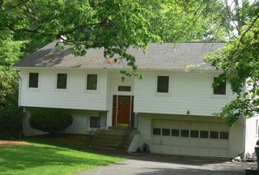
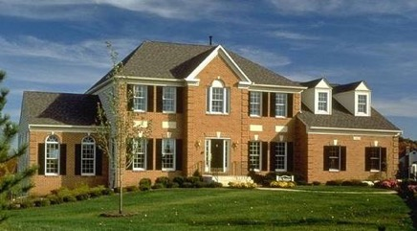
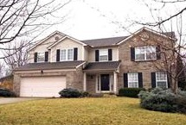
American Housing Styles - 1970’s - 2000’s

Slide 12
1A. Tour your community and list the different building types you see. Try to identify buildings that can be associated with a specific period of history or style of architecture. Make a sketch of the building you most admire. 1B. Select an architectural achievement that has had a major impact on society. Using resources such as the Internet (with your parent's permission), books, and magazines, find out how this achievement has influenced the world today. Tell your counselor what you learned. 4. Measure a room such as one where you live or where your troop meets. Make an accurately scaled drawing of the room's floor plan showing walls, doors, closets, windows, and any built-in furniture or cabinets. Neatly label your drawing with the following: your name, the date, what room you drew, and the scale of the drawing. (Drawing scale: 1/4 inch = 1 foot)
Homework - Session 1

Slide 13
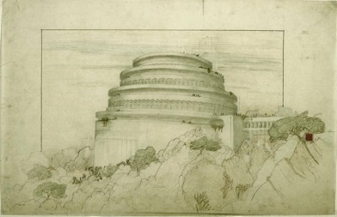
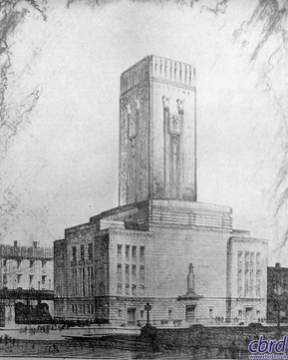
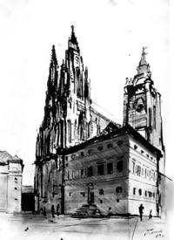
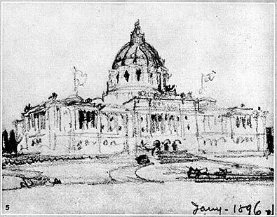
Sketches

Slide 14
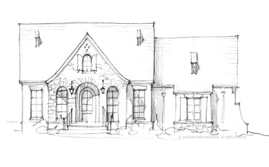
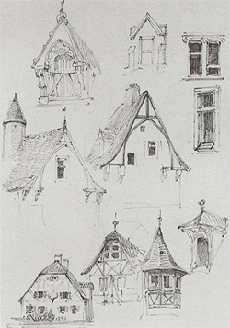
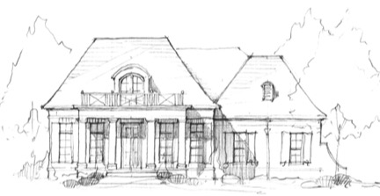
Sketches

Slide 15
Floor Plan Examples

Slide 16
Drafting Tools

Slide 17
Architecture Merit Badge
Counselor: Mr. John F. Kennedy
Email: jfkennedy@fuse.net Phone: 513.631.5528
17

